Slide 1
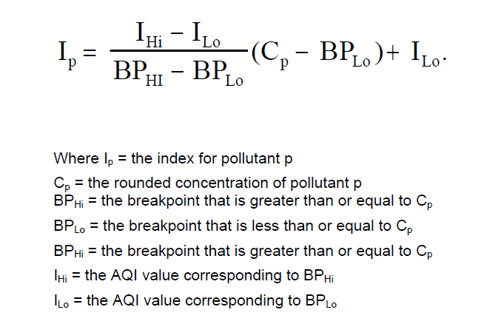
IAQI = Indoor Air Quality Index
CO (ppm) | NO2 (ppm) | O3 (ppm) | PM2.5 (µg/m3) | TVOC (Index) | IAQI | IAQI Status
0.0- 4.4 | 0.000- 0.053 | 0.000- 0.060 | 0-25 | 0-100 | 0-25 | Good
4.5- 9.4 | 0.054- 0.100 | 0.061- 0.124 | 25.1-55 | 101-200 | 25-50 | Moderate
9.5- 15.4 | 0.101- 1.649 | 0.125- 0.404 | 55.1-250 | 201-350 | 50-75 | Unhealthy
15.4- 50.0 | 1.65 - 3.00 | 0.405- 0.1 | 250.1-500 | 351-500 | 75-100 | Hazardous
$IAQI=\max{ \{}I_{CO}, I_{NO2},I_{O3}, I_{PM2.5},I_{TVOC}\}$

Slide 2
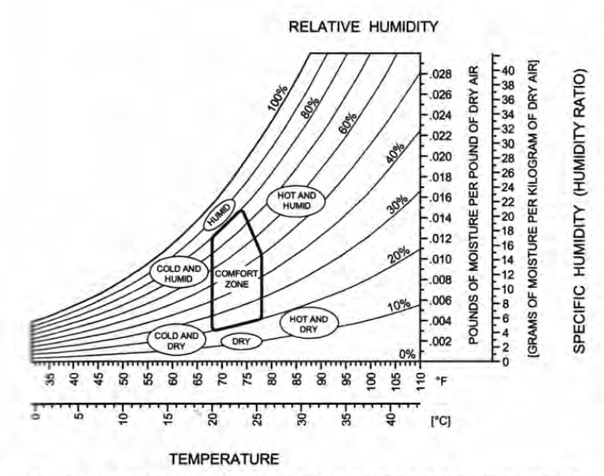
Thermal Comfort
T (Degree C) | RH (%) | Thermal Status
0-20 | 0-20 | Cold and Dry
0-20 | 20-80 | Cold
0-20 | 80-100 | Cold and Humid
20-26 | 80-100 | Humid
20- 26 | 20 -80 | Comfort Zone
26-55 | 0-20 | Hot and Dry
26-55 | 20-80 | Hot
26-55 | 80-100 | Hot and Humid
20-26 | 0-20 | Dry
Psychrometric chart

Slide 3

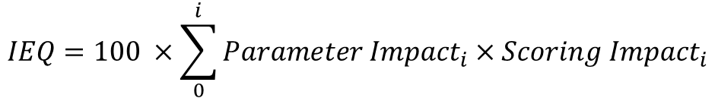
Indoor Environment Quality (IEQ)
Ventilation
Air Quality
Thermal Comfort
CO2 (ppm) | CO (ppm) | NO2 (ppm) | O3 (ppm) | PM2.5 (µg/m3) | TVOC (Index) | T (Degree C) | RH (%) | Score | Scoring Impact
340- 600 | 0.0- 4.4 | 0.000- 0.053 | 0.000- 0.060 | 0-25 | 0-100 | 20- 24 | 40 -60 | Good | 0
601- 1000 | 4.5- 9.4 | 0.054- 0.100 | 0.061- 0.124 | 25.1-55 | 101-200 | 16-20 | 60.1- 80 | Average | 0.25
1001- 1500 | 9.5- 15.4 | 0.101- 1.649 | 0.125- 0.404 | 55.1-250 | 201-350 | 24-26 | 80.1- 90 | Poor | 0.50
1501- 5000 | 15.4- 50.0 | 1.65 - 3.00 | 0.405- 0.1 | 250.1-500 | >350 | T<16 or T>26 | RH<40 or RH> 90 | Bad | 1.0
Parameter impact
33.3%
1.1%
1.1%
1.1%
20%
10%
16.6%
16.6%
$$IEQ=100 ×\sum_{0}^{i}{{Parameter Impact}_{i}×{Scoring Impact}_{i}}$$
Good
Average
Poor
Bad
When IEQ is not “Good” we should report the causing parameter(s) along with appropriate recommendations to improve IEQ

Slide 4

Wellbeing/Wellness Index
CO2 (ppm) | PM2.5 (µg/m3) | TVOC (Index) | T (Degree C) | RH (%) | Score | Scoring Impact
340- 600 | 0-25 | 0-100 | 20- 24 | 40 -60 | Good | 0
601- 1000 | 25.1-55 | 101-200 | 16-20 | 60.1- 80 | Average | 0.25
1001- 1500 | 55.1-250 | 201-350 | 24-26 | 80.1- 90 | Poor | 0.50
1501- 5000 | 250.1-500 | >350 | T<16 or T>26 | RH<40 or RH> 90 | Bad | 1.0
Parameter impact
25%
25%
25%
12.5%
12.5%
$$Wellbeing Index=100 ×\sum_{0}^{i}{{Parameter Impact}_{i}×{Scoring Impact}_{i}}$$
Good
Average
Poor
Bad

Slide 5
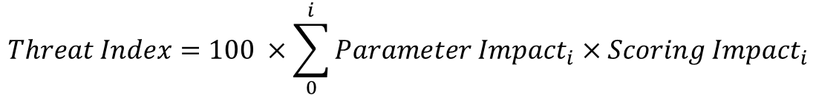
Health Index
CO2 (ppm) | PM2.5 (µg/m3) | T (Degree C) | RH (%) | Score | Scoring Impact
340- 1000 | 0-35 | 20- 24 | 40 -60 | Low | 0
1001- 1500 | 35.1-100 | 16-20 | 60.1- 80 | Moderate | 0.50
1501- 2500 | 100.1-250 | 24-26 | 80.1- 90 | High | 0.75
2501- 5000 | 250.1-500 | T<16 or T>26 | RH<40 or RH> 90 | Extreme | 1.0
Parameter impact
50%
30%
10%
10%
$$Threat Index=100 ×\sum_{0}^{i}{{Parameter Impact}_{i}×{Scoring Impact}_{i}}$$
Low
Moderate
High
Extreme
When Health Index is not “Low” we should report the causing parameter(s) along with appropriate recommendations to improve this index

Slide 6
Regional AQI
These are standard regulatory AQIs established by the local government for outdoor air quality

Slide 7
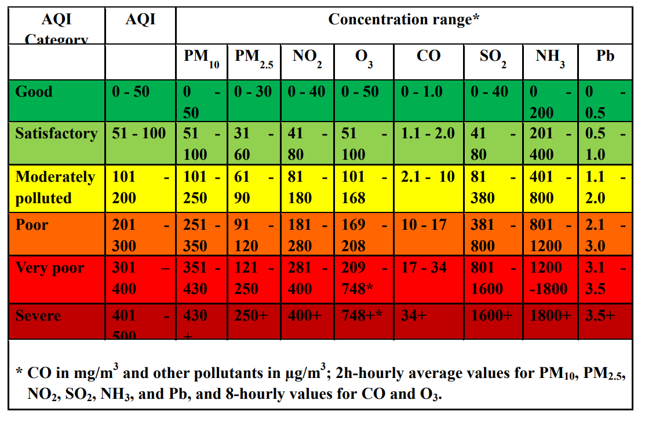
India
Source: https://app.cpcbccr.com/ccr_docs/About_AQI.pdf

Slide 8
Singapore
???

Slide 9
Thailand
???

